Slide 1

EXPLORING STUDENT VETERAN BARRIERS
Alexandra Brandriff
Dr. Roger “Mitch” Nasser
Dr. Kevin Winslow
Dr. Sherrie Wisdom

Slide 2
Thank You!
Dr. Nasser (Chair)
Dr. Winslow & Dr. Wisdom (Committee Members)
To everyone who was gracious enough to spend part of their day with me for my defense

Slide 3
Why This Topic?
Family inspired this topic, especially my brother and sister who both did 10 years in the United States Army, both of which started their higher education, but did not finish.

Slide 4
Purpose
The purpose of my dissertation study was:
  Discover what barriers & challenges student veterans have throughout their higher education journey using student veterans' perspective.
  Discover if student veteran specific resources were sufficient
  Discover if student veterans are retained and graduated like that of traditional students
Notes:
The lean amount of literature surrounding student veterans provides inadequate knowledge of what to expect when it comes to their transition after exiting the military and what expectations and experiences they have as college students. I wanted to understand the barriers the student veteran population face, programs offered to veterans attending higher education institutions and most importantly what student veterans themselves had to say about the issues they faced and programs they utilized.
The second half of this study examined student veterans' retention and graduation rates compared to traditional students. It goes further to examine student veteran retention and graduation rates for veterans using veteran assistance programs versus those who aren’t using those same programs.

Slide 5
Review of Literature
Theoretical Framework
Schlossberg’s Theory of Transition
Schlossberg et al. (1995) define transition as “any event, or nonevent, that results in changed relationships, routines, assumptions, and roles” (p. 27).
Three types of transitions and the 4 S’s (Akerman et al., 2009, Schlossberg et al., 1995)
Students need to have a sense of belonging and see themselves as a member of the community. If students feel out of place, without a sense of belonging, they can lose the motivation to persist (Tinto, 2017).
Tinto’s Interactionalist Theory
Notes:
She initially wanted to understand adult men’s experiences when wishing to change careers. She later extended her ideas regarding her transition theory, which suggested that individuals go through transitions that can be anticipated or unanticipated. Social factors such as her four S’s which include situation, self, support and strategy are the social factors that help the individual get through the transition through successfully.
Tinto believed that student involvement was critical in positive academic outcomes for higher education students and that there was a need to understand further the relationship between student involvement and its impact on student persistence. He believed that the more students learn, the more likely they will have a positive academic outcome. He also noted that students must want to persist even in the face of challenges that they will encounter. The goal is finishing the degree; however, that is not a sufficient condition behind the motivation. Students must be motivated, which can be strengthened or weakened based on the experiences the students have. Self-efficacy, a sense of belonging, and the perception of the curriculum are the driving factors behind motivation.

Slide 6
Review of Literature
Barriers and Challenges
Strongest Veteran Barriers/Challenges shown in literature
  Social Isolation (Griffin & Gilbert, 2015, Schiavone & Gentry, 2014, Wheeler, 2012)
  Financial Issues (Griffin & Gilbert, 2015)
  Psychological Issues (López et al., 2016, Messerschmitt-Coen, 2021, Ryan et al., 2011)
Institutional Challenges
  Re-enrollment Process (Falkey, 2016)
  Resource knowledge – specifically regarding GI Bill (McBain, 2009)
Notes:
One of the most complicated challenges associated with student veterans is connecting with their non-veteran classmates. Research has shown that veterans are more likely to appreciate the opportunity to be around other student veterans than traditional student peers and that relating with peers at least three years younger than them was a struggle at times.
When attending college, the financial aspect can cause stress for any student, let alone a student veteran. Although veterans have the GI Bill to help with their tuition and other college-related expenses, exiting the military and leaving a steady source of income can come with its own stress and complications. Their financial situation has been dramatically impacted by not having a steady paycheck, with all the same financial responsibilities.
It is not uncommon for veterans to exit the military with disabilities, mental or physical. Veterans can be highly susceptible to mental health stressors, leading to roughly 41% of veterans being diagnosed with substance use disorder or mental health conditions. The two common injuries discussed are Post Traumatic Stress Disorder (PTSD) and Traumatic Brain Injury (TBI). Unfortunately, most veterans do not report their issues with mental health and these health issues can make veterans who suffer from them feel very isolated, guilty, depressed, or blame themselves, which can cause it to be difficult for them to seek help.
Moving on to institutional challenges, a students success relies not only on the student but also the institution. On top of the barriers student veterans face individually, institutions can cause barriers as well. For example, literature discussed that some institutions make the re-enrollment process very tedious if they take a break during semesters. Also, the VA benefits such as the GI Bill can be pretty complicated to navigate, and often institutional staff are not fully equipped to help throughout the benefit enrollment process.

Slide 7
Methodology
Mixed Methods Study
Gathering the Data
  Qualtrics Survey
Retention & Graduation Data Analyzed
  Retention Data (2019, 2020, 2021) for all veteran students
  Retention Data (2019, 2020, 2021) for non-veteran students
  Retention Data (2019, 2020, 2021) for veterans using VA Programs
  Retention Data (2019, 2020, 2021) for veterans not using VA Programs
  Graduation Rates (2015, 2016, 2017 Cohorts) for non-veteran students
  Graduation Rates (2015, 2016, 2017 Cohorts) for veteran students.
Notes:
I used a mix methods strategy due to it having both qualitative and quantitative parts to this study.
The qualitative piece of this study was important for me to understand the challenges and issues face by student veterans, from student veterans themselves. On top of this, I also obtained their perceptions on different programs that were offered and if they found them truly beneficial. Based on their own perspectives, I could discern whether resources were proving beneficial or inadequate for them. To gather the qualitative data, I put together a survey that was sent from the VA center to all student veterans veterans enrolled. The survey included multiple choice and open-ended questions to ensure a comprehensive examination of participants' experiences. The multiple-choice questions were utilized as an initial screening mechanism to identify respondents who met the specific criteria necessary for participation in the survey. The purpose of these open-ended questions was twofold: first, to capture participants' perceptions of the support programs available to them during their higher education journey, and second, to explore the challenges they faced throughout this period.
The quantitative data for this study was obtained from the institution by requesting retention and graduation rates for specific cohorts: retention rates for the years 2019, 2020, and 2021, and graduation rates for the years 2015, 2016, and 2017. The the data I utilized was sourced from the Institutional Research Office, which provided reliable and precise numerical data on these rates. After receiving the quantitative data, I sorted and analyzed it it by categorizing the cohorts and determining retention and graduation based on student ID numbers. This prepped the data for me to run my testing.

Slide 8
Methodology
Participants
  285 student veterans were sent the survey link
  34 student veterans responded
  28 qualified
Testing
  A z-test of proportions was used to compare graduation rates between traditional students and student veterans because this statistical test is designed to determine if there is a significant difference between the proportions of two independent groups.
Notes:
The survey was sent to 285 student veterans, which were all the active students enrolled at the time. I used a convenience sample as it was accessible directly to me from the institution.
34 student veterans responded to the survey and of those, 28 qualified to participate in the survey. The criteria for participation included: a) the veteran must be enrolled as a full-time or part-time undergraduate student at the subject institution, served at least two years in the Armed Forces, and not active duty (reserves and national gaurd). Due to regulations, all active-duty personnel were excluded from this study.
A z-test of proportions was used to test the quantitative data sets for graduation and retention. This is because a z-test of proportions is specifically used when dealing with categorical data and I needed to compare the proportion of a certain characteristics (being graduation rates and retention rates) between two groups.

Slide 9
Hypotheses
Null Hypothesis 1: There is no statistically significant difference in graduation rates between traditional students and student veterans.
Null Hypothesis 2: There is no statistically significant difference in retention rates between traditional students and student veterans.
Null Hypothesis 3: There is no statistically significant difference in retention rates between student veterans using VA programs offered by the institution and student veterans not using programs.
Null Hypothesis 4: There is no statistically significant difference in graduation rates between student veterans using the VA programs offered by the institution and student veterans not using those programs.
Notes:
I formulated four null hypotheses for my study. The first pair focused on comparing graduation and retention rates between traditional students and student veterans.
The second pair focused on comparing graduation and retention rates between student veterans using veteran programs and those not using veteran programs.

Slide 10
Research Questions
Research Question 1: How do the current veterans' programs being offered actually help veterans throughout their four-year degree program?
Research Question 2: Are the programs offered to student veterans helping them academically or just during the admissions process?
Research Question 3: What program, based on student veterans’ perspectives, benefits them most and why?
Research Question 4: What can universities do to support veterans’ success in higher education in addition to the veteran programs offered?
Notes:
My first two research questions are closely related. I aimed to determine whether the programs utilized by student veterans provide consistent support throughout their four-year program or primarily assist during the admissions process.
For my third research question, I sought to gather perspectives directly from student veterans, as they are the best source to assess the effectiveness of the programs.
My fourth research question focuses on identifying ways higher education institutions can enhance their support for student veterans. While some support measures may already be in place, I wanted to explore additional strategies from the veterans' viewpoints.

Slide 11
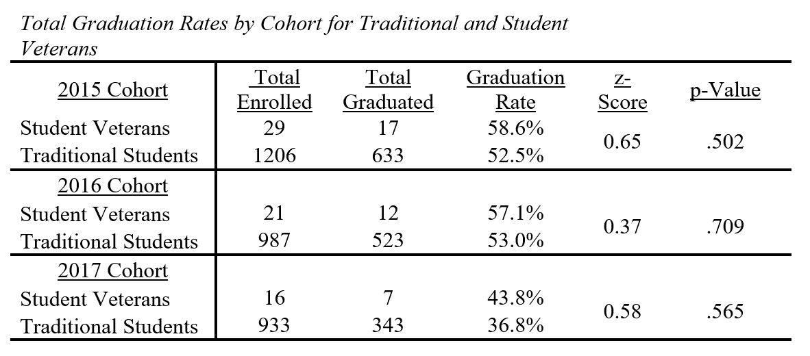
Study Results
  Null Hypothesis 1 - There is no statistically significant difference in graduation rates between traditional students and student veterans.
    Failed to reject the null
Notes:
When testing the for a significant difference between graduation rates among student veterans and traditional students, I failed to reject the null since the p-values are greater than the significance level of 0.05. There is not enough statistical evidence to suggest a significant difference the graduation rates between these two student groups.

Slide 12
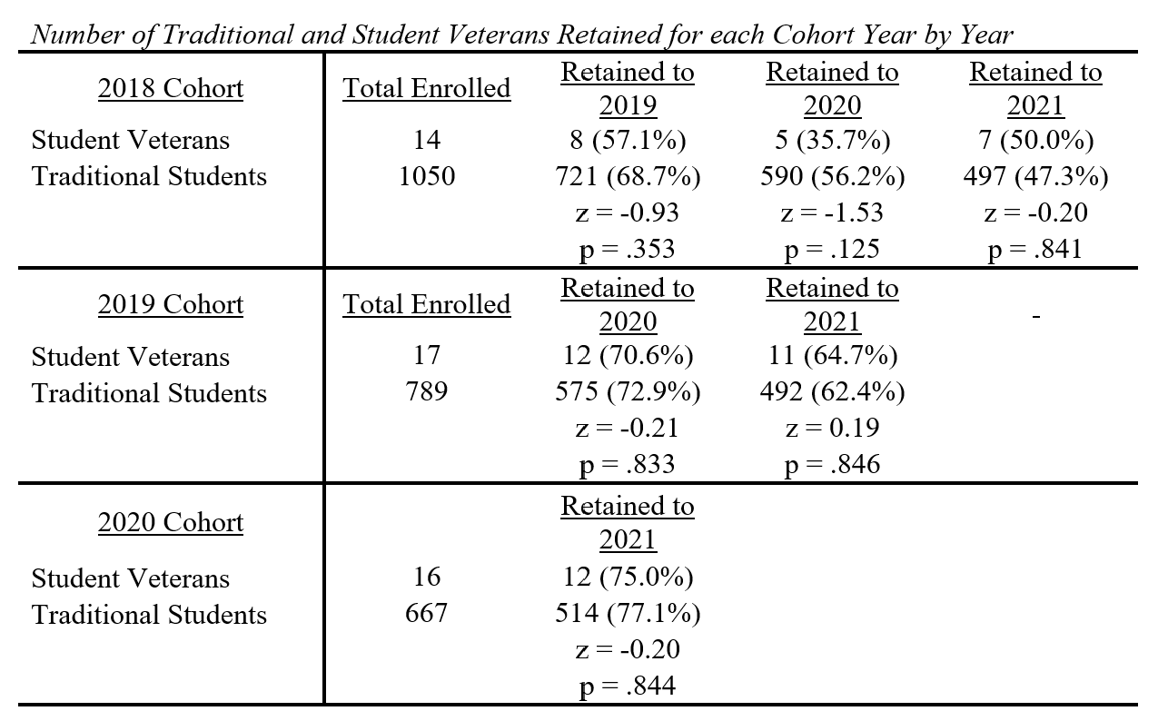
Study Results
  Null Hypothesis 2 - There is no statistically significant difference in retention rates between traditional students and student veterans.
    Failed to reject the null
Notes:
When testing the for a significant difference between retention rates among student veterans and traditional students, I failed to reject the null since the p-values are greater than the significance level of 0.05. There is not enough statistical evidence to suggest a significant difference the retention rates between these two student groups.

Slide 13
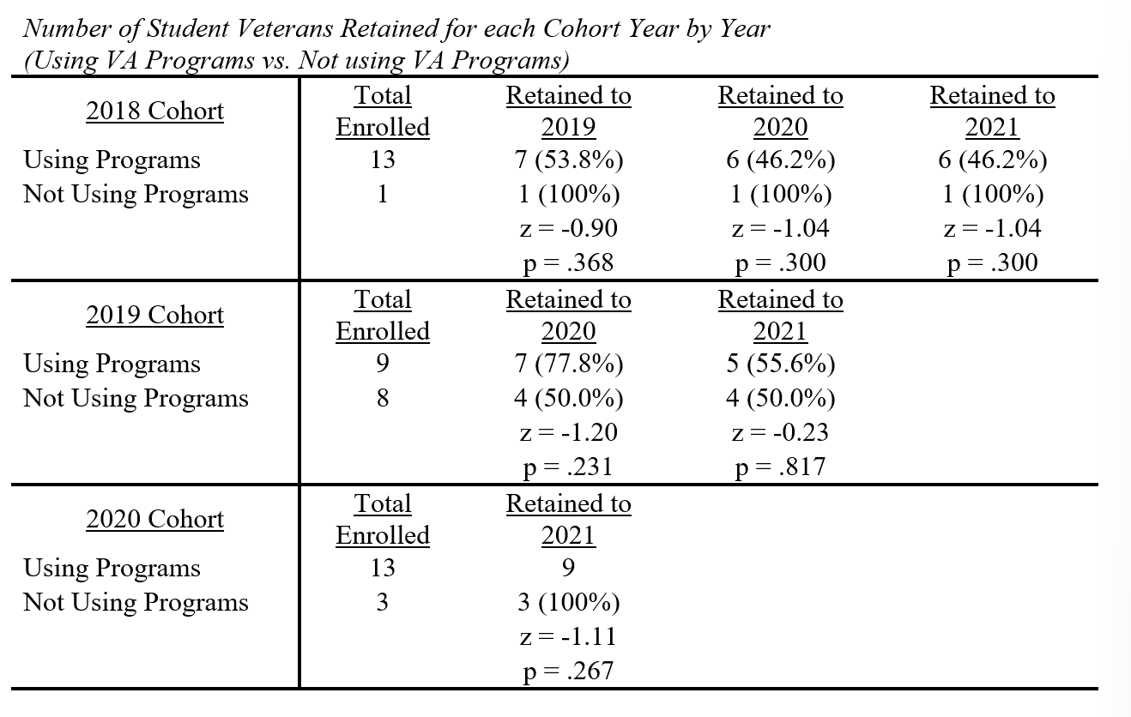
Study Results
  Null Hypothesis 3 - There is no statistically significant difference in retention rates between student veterans using VA programs offered by the institution and student veterans not using programs.
  Failed to reject the null
Notes:
I failed to reject the null since the p-values are greater than the significance level of 0.05 when testing the for a significant difference between retention rates among student veterans using VA programs versus those not using VA programs. There is not enough statistical evidence to suggest a significant difference the graduation rates between these two student groups.

Slide 14
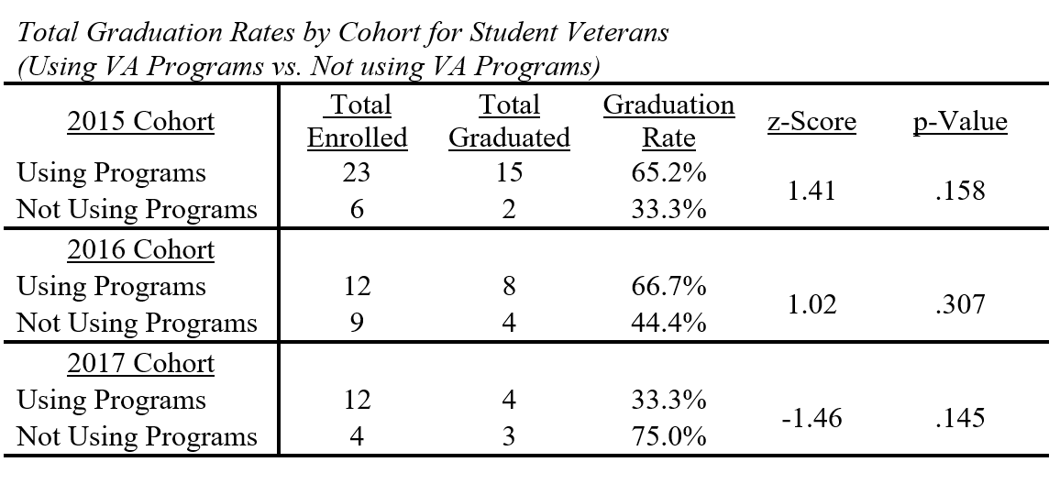
Study Results
  Null Hypothesis 4 - There is no statistically significant difference in graduation rates between student veterans using the VA programs offered by the institution and student veterans not using those programs.
  Failed to reject the null
Notes:
When testing the for a significant difference between graduation rates among student veterans using programs versus those who are not, I also failed to reject the null since the p-values are greater than the significance level of 0.05. There is not enough statistical evidence to suggest a significant difference the graduation rates between these two student groups.

Slide 15
Study Results
Research Questions
  Research Question 1: How do the current veterans' programs being offered actually help veterans throughout their four-year degree program?
    Themes
      Importance of Tuition Assistance (GI Bill)
      Importance of Student Veteran Group
  Research Question 2: Are the programs offered to student veterans helping them academically or just during the admissions process?
    Themes
      Importance of Tuition Assistance (GI Bill)
      Importance of Student Veteran Group
      Importance of Veteran Readiness and Employment (VR&E)
Notes:
Research Question 1: The two recurrent themes throughout this study are tuition assistance and student veterans group. These two programs assist student veterans with financial and social support throughout their higher education journey.
The most frequently utilized program was Military Tuition Assistance/GI Bill, with 10 participants specifically indicated that Military Tuition Assistance/GI Bill significantly impacted their ability to continue their education. Another key theme from the survey responses was the effectiveness of the institution’s Student Veteran Group.
This group offers a sense of security among peers with similar mindsets, life experiences, and often ages. Given that social isolation is a significant barrier for student veterans in higher education, the Student Veteran Group provides essential support. Participants described the group using terms like “camaraderie” and “welcoming.”
Research Question 2: As you will observe, the themes of tuition assistance and student veteran groups are prevalent across all four research questions. Several participants in this study shared positive experiences with both tuition assistance and student veterans' group.
Regarding tuition assistance, one participant remarked: "The Post-911 GI Bill has been extremely beneficial. My tuition has been fully covered every semester." Another added, "I've utilized GI Bill benefits since starting college. The benefits are excellent. They cover 60% of my tuition, and I also receive a monthly stipend (Basic Allowance for Housing) and a book allowance.” Additionally, comments about the student veteran group included: "They were supportive, and the student veteran group was very welcoming. It was reassuring to know there were many other veterans enrolled with me.” and "It was comforting to know there were many other veterans enrolled, sharing similar life experiences to mine.”
Another theme that was presented was in regard to the Veteran Readiness and Employment (VR&E) program. This is a program that the VA offers and is not a collaboration with higher education institutions, so little info is known in regards to this study.

Slide 16
Study Results
Research Questions
  Research Question 3: What program, based on student veterans’ perspectives, benefits them most and why?
    Themes
      Importance of Tuition Assistance (GI Bill)
      Importance of Student Veteran Group
  Research Question 4: What can universities do to support veterans succeed in higher education in addition to the veterans' programs offered?
    Themes
      Importance of Social Isolation Prevention
      Importance of Veteran Communications/Resource Awareness
      Importance of Creating Expectations
      Importance of Creating a Safe Space for Student Veterans
Notes:
Research Question 3: Reflecting on the challenges faced by student veterans, financial strain and social isolation emerge as significant barriers. Two prominent themes that have emerged from research are tuition assistance and student veterans' groups. These programs are particularly beneficial because they directly address the primary challenges veterans encounter: financial instability and feelings of isolation.
The GI Bill typically covers a substantial portion, if not all, of their tuition costs, along with allowances for books and housing in many cases. This support is crucial in easing the transition from military service, where steady income is no longer guaranteed. Additionally, student veterans' groups play a vital role by connecting these individuals with peers who share similar life experiences. This camaraderie fosters a sense of belonging and understanding among student veterans, helping them navigate their challenges more effectively.
Research Question 4: Social isolation can significantly impact a student veteran's success in higher education. Institutions play a crucial role in supporting peer groups like student veteran groups. Many participants emphasized the need for universities to better promote these resources. They suggested advertising student veteran groups more effectively and creating a stronger sense of community among student veterans. Some were unaware of the existence of such groups until later in their academic journey, which limited their access to peer support.
Communication about veteran resources emerged as a key theme. Many student veterans expressed confusion about VA benefits, application processes, and approval times. They highlighted the need for university staff who are well-trained and knowledgeable about the intricacies of the GI Bill.
Setting clear expectations also emerged as important. Many student veterans find the transition from military service to higher education daunting, especially in understanding academic workloads and standards. Participants stressed the importance of universities being transparent about what to expect academically, emphasizing that success requires significant effort.
Creating safe spaces was identified as crucial for student veterans. These spaces provide a supportive environment where they can freely express themselves, share experiences, and collaborate with peers. Criticism arose regarding the physical location of the VA Center on campus, with concerns about accessibility and comfort.

Slide 17
Interpretation
Limitations of the Study
  Sample Size
  Voluntary Survey
  Responses Could Be Skewed/Vary
Recommendations for Future Study
  Additional Survey Questions
  Gift for participation
  More than one institution being studied
Recommendations for Practice
  Understand the veteran experience
  Provide academic support
  Request feedback from student veterans
  Strive to be veteran friendly
Notes:
Limitations: The small sample size of 28 could raise concerns about the generalizability of the findings beyond the studied university. Including multiple institutions would have enabled broader insights into student veteran perceptions. Responses might differ across institutions depending on the availability of specific programs or groups. Also, the survey relied on voluntary participation without incentives, and the presence of open-ended questions may have discouraged some participants from completing it due to the time required.
Recommendations for Future Study:
Additional Survey Questions such as:
Was the VA Center at [university] knowledgeable about resources and programs offered specifically to veterans?
How many months/years were between your military exit and your higher education enrollment?
Did you attend college before entering the military?
These would help fill in any gaps and help gain a better understanding of why students answered questions they way they did. The bullet point addressing limitations discussed utilizing incentives to encourage a strong response, and it also encompassed the inclusion of multiple institutions in the study. This inclusion would be beneficial because different institutions may offer various programs that could potentially have a more significant impact on the student veteran population.
And lastly, a few recommendations for practice… Faculty and staff should actively support and accommodate student veterans throughout their academic journey. Direct engagement with student veterans allows them to share their perspectives on challenges and successes. Training should cover available resources for student veterans and educate on issues like TBI and PTSD, common diagnoses among veterans.
Understanding military/veteran culture, challenges in transitioning to higher education, and potential disabilities equips educators with essential knowledge to effectively support student veterans. Institutions can support student veterans comprehensively by establishing a VA resource center staffed with knowledgeable advisors to assist with academic needs and benefits access. This includes both internal programs like veterans’ groups and external resources such as military tuition assistance/GI Bill benefits.
Specialized counseling services addressing veterans' unique needs, such as transitioning from military service, managing PTSD, and setting academic expectations, are also crucial. Workshops tailored for veterans transitioning to civilian academic life can provide further support by bridging the gap in expectations. Developing a deep understanding of military culture is essential for fostering a sense of belonging and inclusivity, while offering resources tailored to this unique student population.
One way to assess whether the institution fulfills its duties as a higher education institution is by soliciting feedback from student veterans. This feedback is crucial for evaluating whether the institution provides the necessary support to meet the needs of student veterans. Feedback can be gathered through various methods: professors can seek input at the end of classes, and the VA center can collect feedback at the end of each semester. Veteran-friendly" lacks a single, universal definition but is commonly understood based on how well an institution supports student veterans through assistance with tuition, communication, admissions, and advisory services. This aligns with previous recommendations, emphasizing the importance of understanding veterans' challenges, transitions, funding, and policies. Hiring veterans across various roles within the institution, including professors, VA Center staff, counselors, and academic advisors, can foster a supportive environment for student veterans.

Slide 18
Questions?

